Slide 1


Slide 2

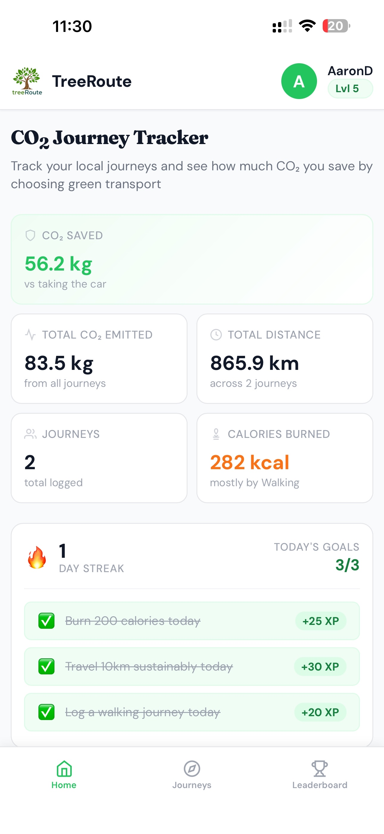
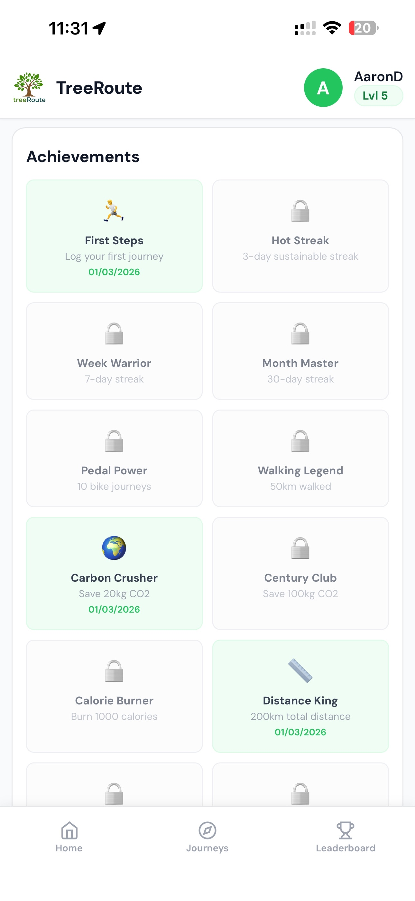

treeRoute
CORE29
Better Way to Travel
Group: Unnamed

Slide 3
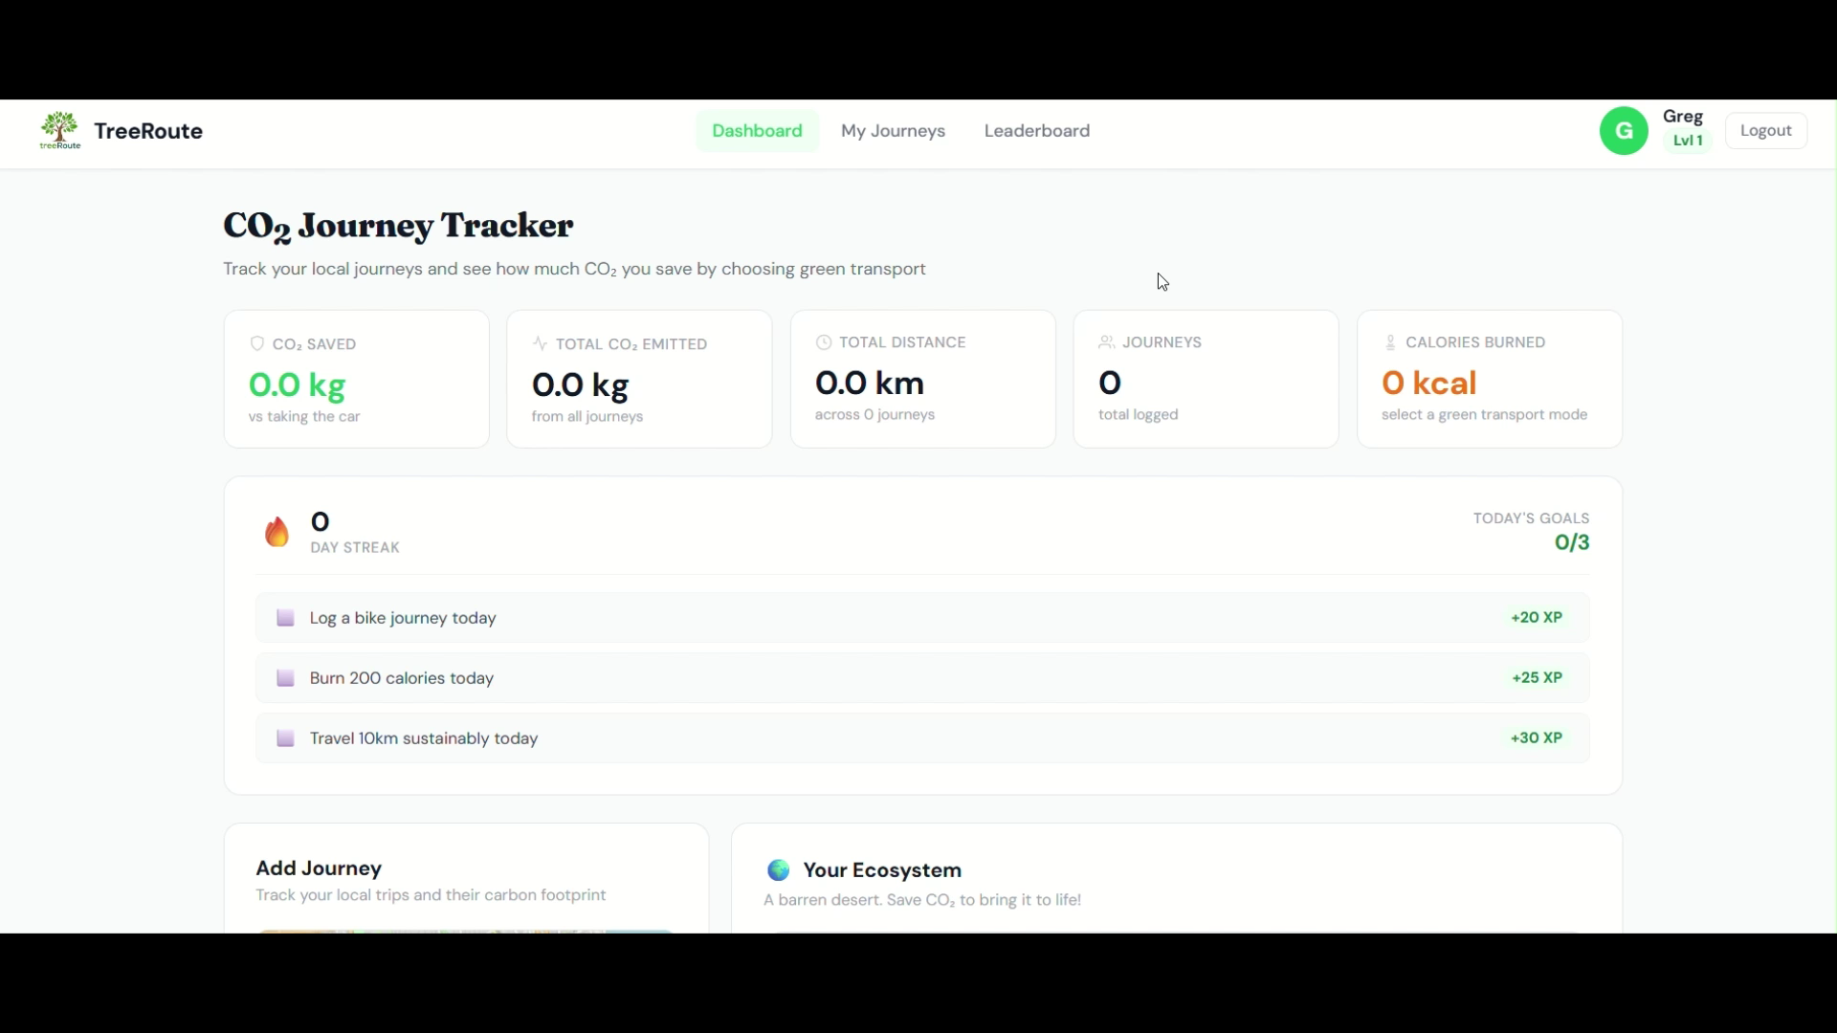

Slide 4
What does the science say?
Individual lifestyle choices drive climate change, biodiversity loss, (Foleyet al. 2005), and water scarcity (Wada and Bierkens2014).
These pressures will worsen as population and wealth grow -(Ferrara and Serrat 2008)
Changing human behavior is key to solving environmental challenges (Fischer et al. 2012; Cowling 2014)
How?

Slide 5
Decisions decisions decisions
System 1 decision making involves fast, effortless thinking we make via shortcuts, because we are 'cognitive misers’. (WeeS.-C., Choong, W.-W. and Low, S.-T. (2021).
System 2 decision involves deliberate thinking. It is more effortful, takes longer, but it is also the pathway to considering the environment. (Wee, S.-C., Choong, W.-W. and Low, S.-T. (2021).
When travelling, people will often gravitate towards SYstem 1 thinking. How does our app help them get to System 2 thinking?

Slide 6
Behavioural Nudging Theory
We use the psychological principles of behavioural nudging (Thaler and Sustein, 2008).
Nudging is an effective policy tool that align goals and action in behavioural change in the general public (Momsen and Stoerk, 2014).
Nudging has gained the support and recommendation in promoting pro-environmental behaviour change (Karlsen and Andersen, 2019; Lehner et al., 2016; Sunstein, 2014)

Slide 7
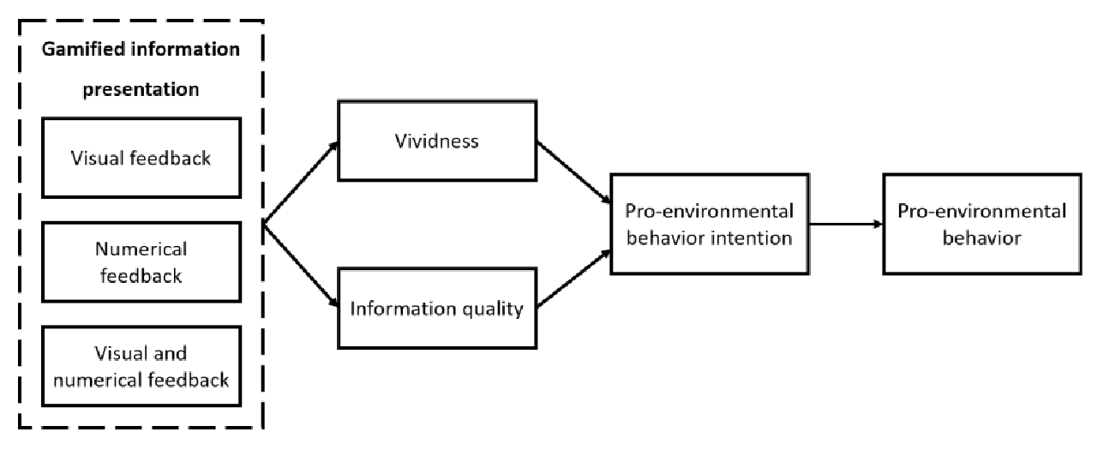
How gamification results in pro-environmental behaviour (Wolf, 2020)
How do we make sure people keep their intention and behaviour?
Notes:
Numerical feedback alone has no significant effecton vividness. However, numerical feedback as well as visual and numerical feedbackcombined have a positive and significant effect on information quality, while visualfeedback alone, in reference to gamified information presentation, has no effect on in-formation quality. Further, both vividness and information quality show positive sig-nificant effects on pro-environmental behavior intention.
https://ceur-ws.org/Vol-2637/paper9.pdf#page=7.32

Slide 8
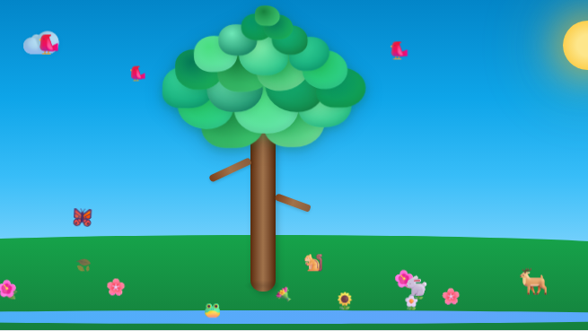

Slide 9
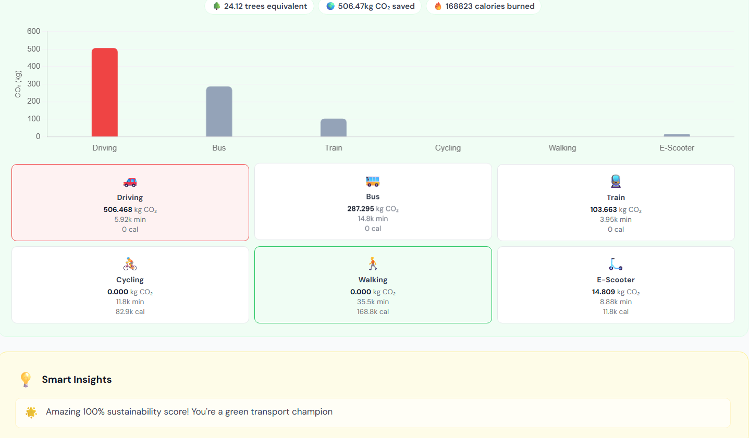

Slide 10
How gamification results in pro-environmental behaviour (Wolf, 2020)
How do we make sure people keep their intention and behaviour?
Notes:
Numerical feedback alone has no significant effecton vividness. However, numerical feedback as well as visual and numerical feedbackcombined have a positive and significant effect on information quality, while visualfeedback alone, in reference to gamified information presentation, has no effect on in-formation quality. Further, both vividness and information quality show positive sig-nificant effects on pro-environmental behavior intention.
https://ceur-ws.org/Vol-2637/paper9.pdf#page=7.32

Slide 11
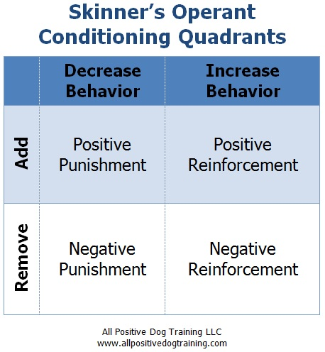
Learning behaviour through operant conditioning
Positive reinforcement – good behaviour => ecosystem grows, encouraging messages
Positive punishment – bad behaviour => ecosystem dies

Slide 12
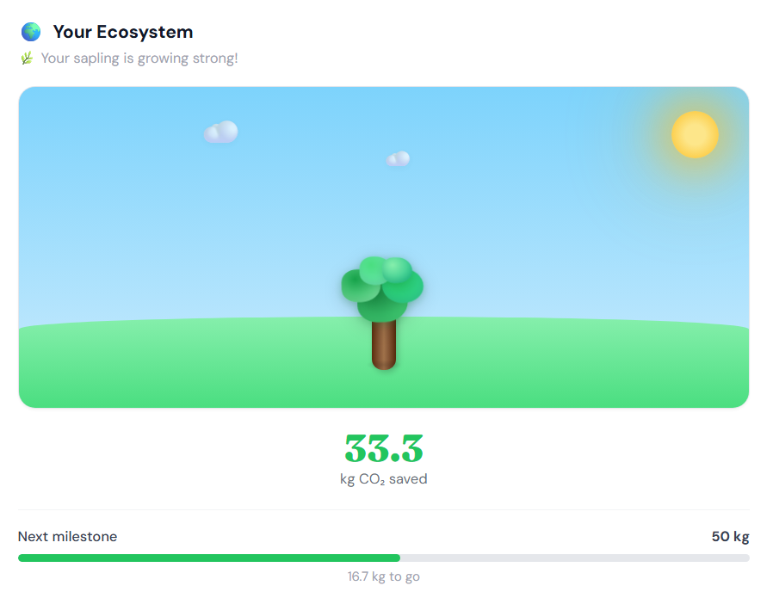
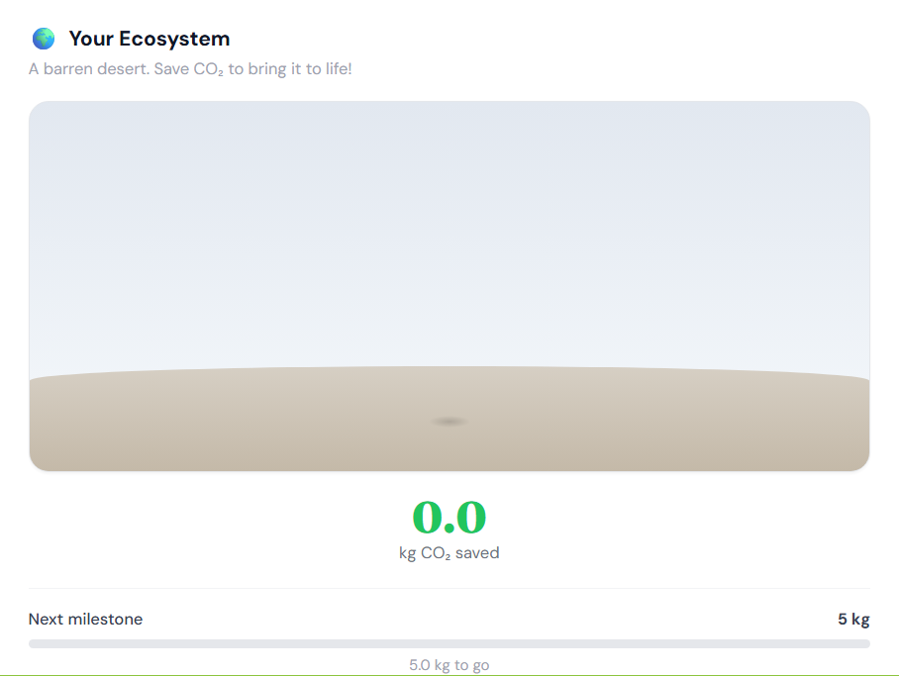

Slide 13
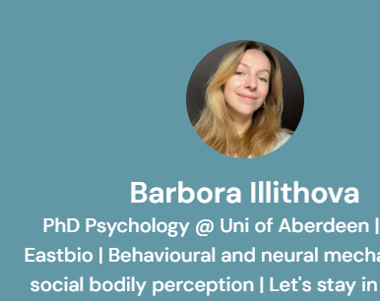
SCIENCE SCIENCE SCIENCE
https://linktr.ee/barbora.illithova

